Slide 1
The Physical Layer
Lecturer: Ngo Huy Bien
Software Engineering Department
Faculty of Information Technology
VNUHCM - University of Science
Ho Chi Minh City, Vietnam
nhbien@fit.hcmus.edu.vn

Slide 2

Objectives

Slide 3

Contents

Slide 4

References

Slide 5
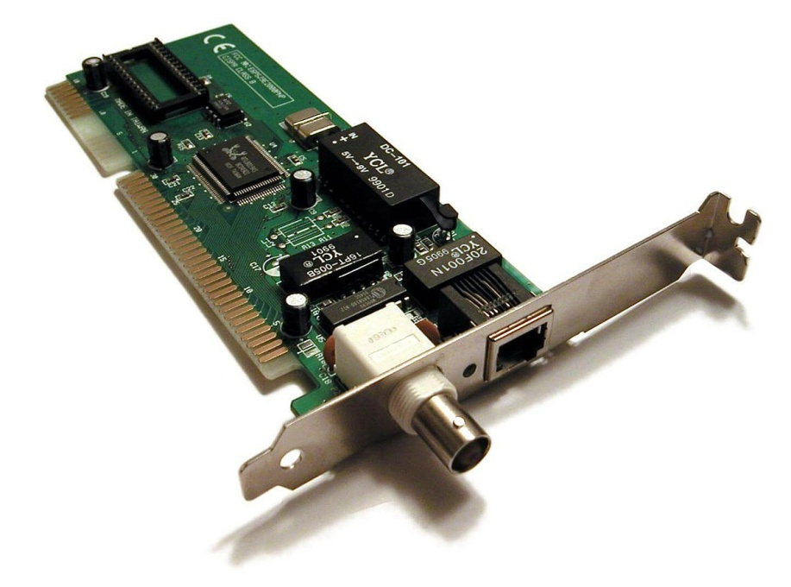
Network Interface Cards

Slide 6
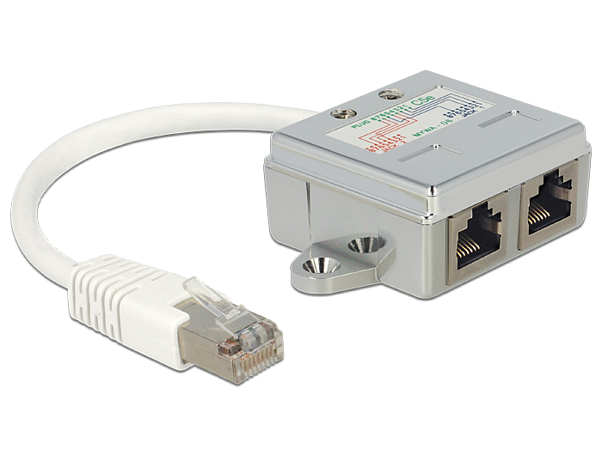
RJ45 Ports and Plugs

Slide 7
Cables
Cables: Insulated wires that connect different devices to each other allowing data to be transmitted over them
Cable categories: Groups of cables that are made with the same material. Most network cables used today can be split into two categories, copper and fiber.
Copper cable categories : These categories have different physical characteristics like the number of twists in the pair of copper wires. These are defined as names like category (or cat) 5, 5e, or 6, and how quickly data can be sent across them and how resistant they are to outside interference are all related to the way the twisted pairs inside are arranged.
Fiber cable: Fiber optic cables contain individual optical fibers which are tiny tubes made of glass about the width of a human hair. Unlike copper, which uses electrical voltages, fiber cables use pulses of light to represent the ones and zeros of the underlying data.

Slide 8
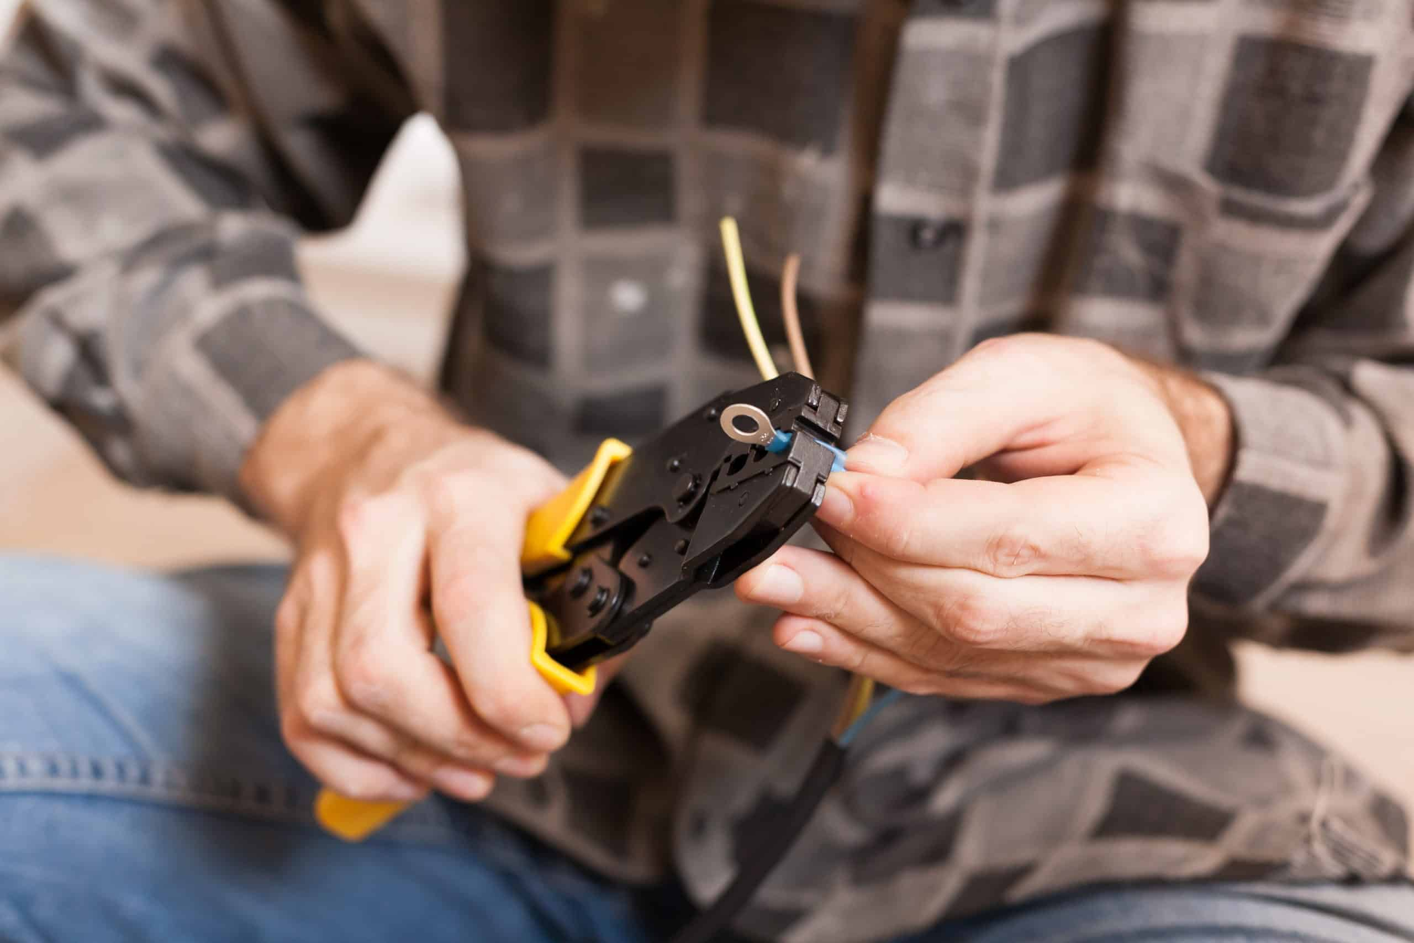
Cabling Tools
Crimper
A crimper is a hand-held tool that looks like a set of pliers. It is used to squeeze down or crimp wires.
Cable Stripper
A cable stripper is another handheld device that also looks like pliers. It's purpose is to remove the protective rubber coating from cables.
…

Slide 9
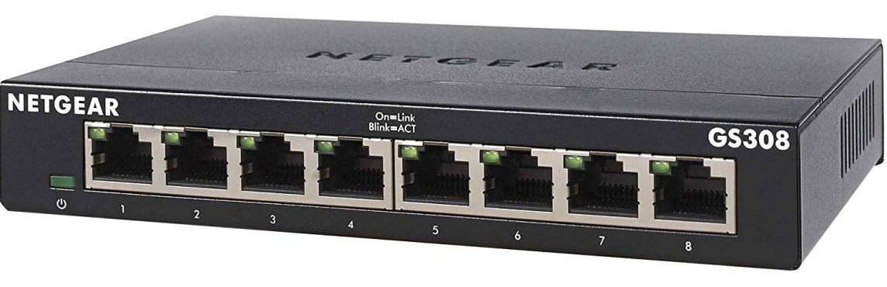
Hubs
Hub: It is a physical layer device that broadcasts data to every computer connected to it.

Slide 10
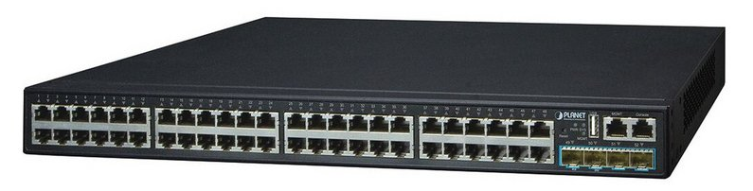
Switches
Network switch: It is a level 2 or data link device that can connect to many devices so they can communicate.
It can inspect the contents of the Ethernet protocol data being sent around the network, determine which system the data is intended for and then only send that data to that one system.

Slide 11
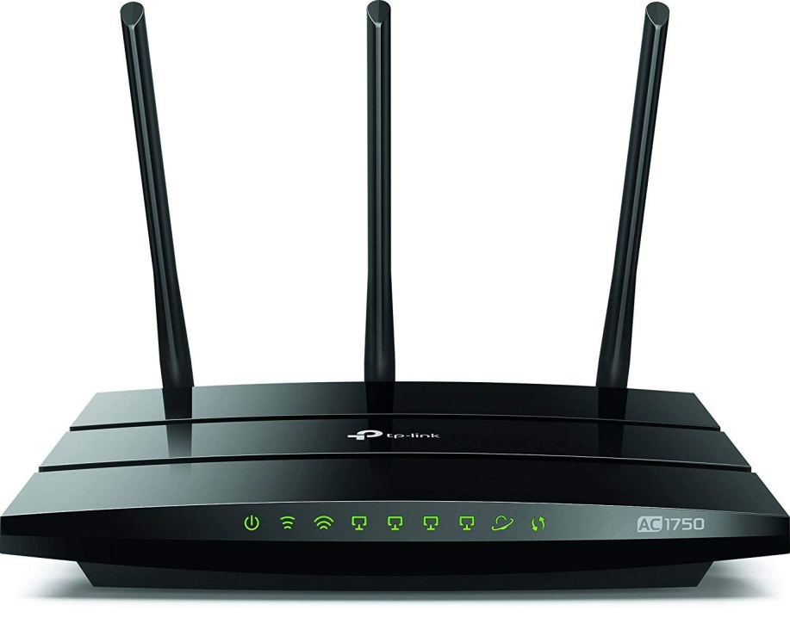
Routers
Router: A network layer device that knows how to forward data between independent networks.

Slide 12
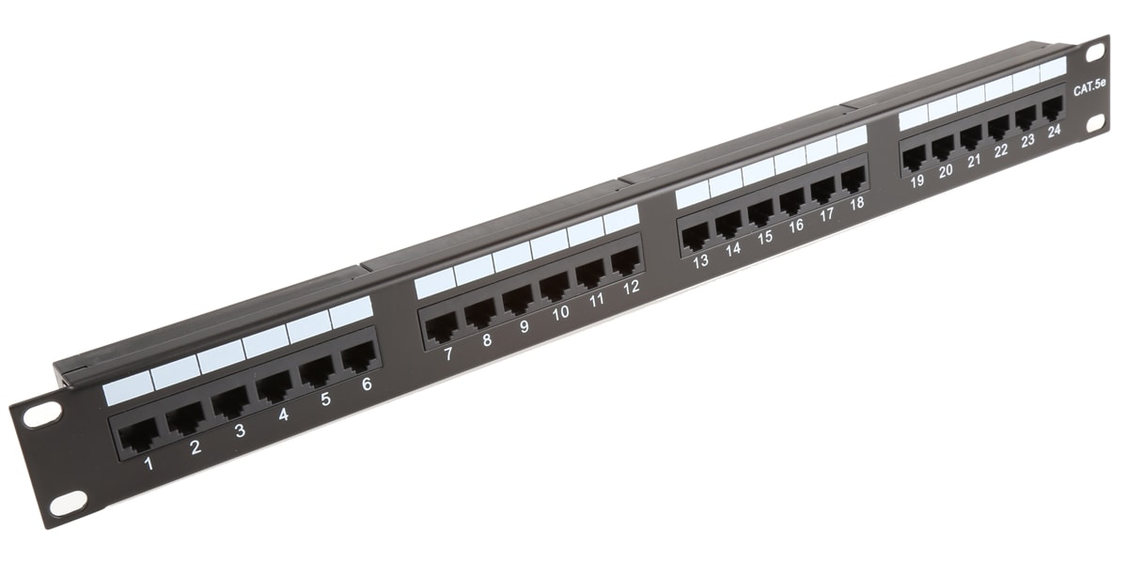
Network Ports and Patch Panel
Network port: The physical connector to be able to connect a device to the network. This may be attached directly to a device on a computer network, or could also be located on a wall or on a patch panel.
Patch panel: A device containing many physical network ports.

Slide 13
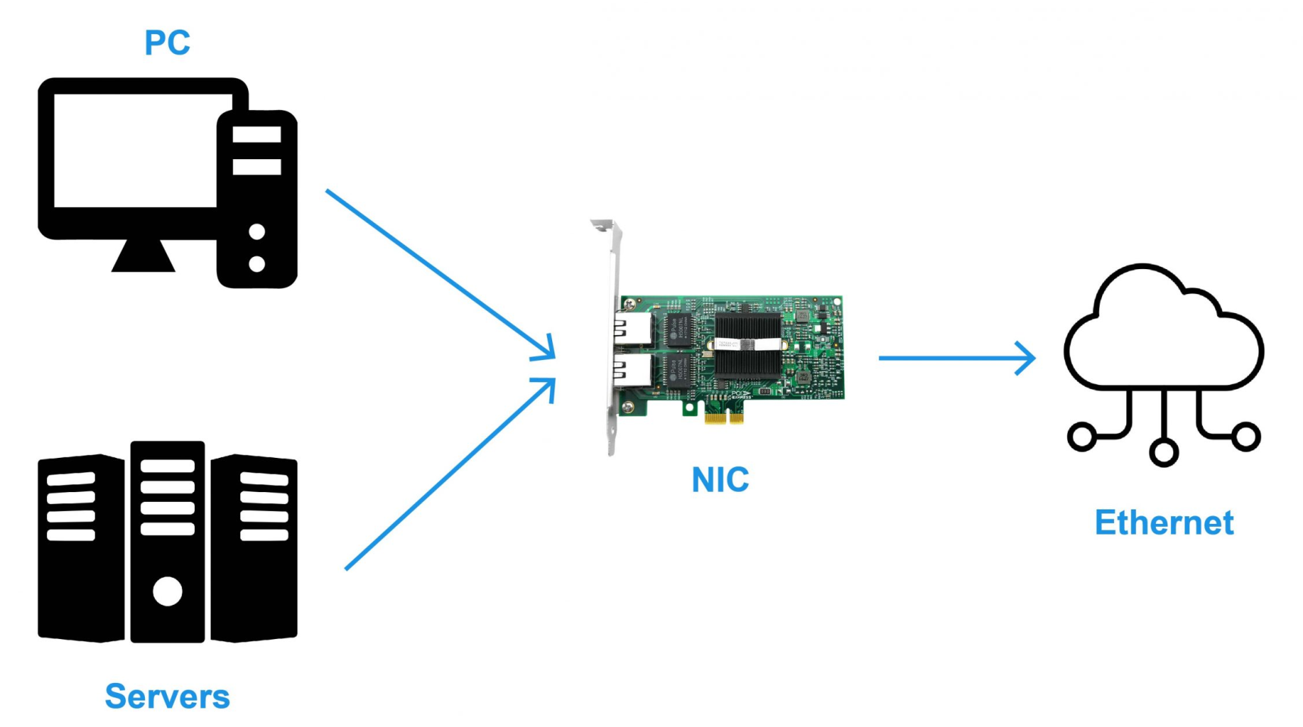
Servers and Clients
Server: A device that provides data to another device that is requesting that data, also known as a client.
Client: A device that receives data from a server.
Node: Any device connected to a network. On most networks, each node will typically act as a server or a client.

Slide 14


Slide 15
Physical Networks
The physical network consists of the cables (coaxial cable, twisted pair, fiber optic, and telephone lines) that connect the different hardware residing on the network, the adapter used on computers connected to the network (hosts), and any concentrators, repeaters, routers, or bridges used in the network.

Slide 16
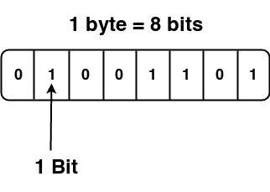
Bit
Bit: The smallest representation of data that a computer can understand (0 or 1).
Octet: Any number that can be represented by 8 bits (byte).

Slide 17
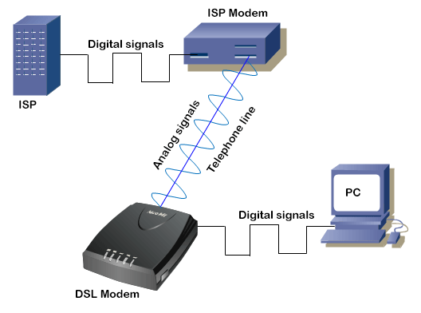
Modulation
Modulation: A way of varying the voltage of a constant electrical charge moving across a standard copper network cable.
Line coding: Modulation used for computer networks.
Digital signals = 01010001

Slide 18
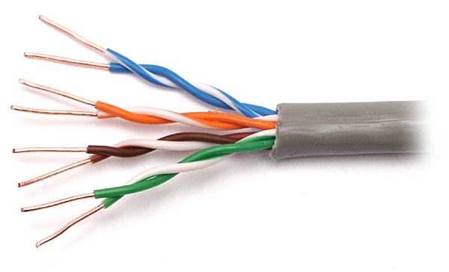
Twisted Pair Cables
Twisted pair cable: The most common type of cabling used for connecting computing devices. It features pairs of copper wires that are twisted together.

Slide 19
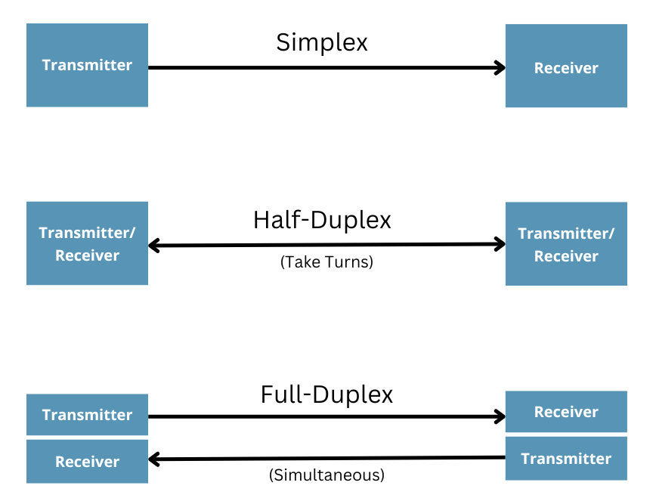
Duplex Communication
Simplex communication: A form of data communication that only goes in one direction across a cable.
Duplex communication: A form of communication where information can flow in both directions across a cable.
Full duplex: The capacity of devices on either side of a networking link to communicate with each other at the exact same time.
Half-duplex: It means that, while communication is possible in each direction, only one device can be communicating at a time.

Slide 20

Thank You & See You Again

